Slide 1
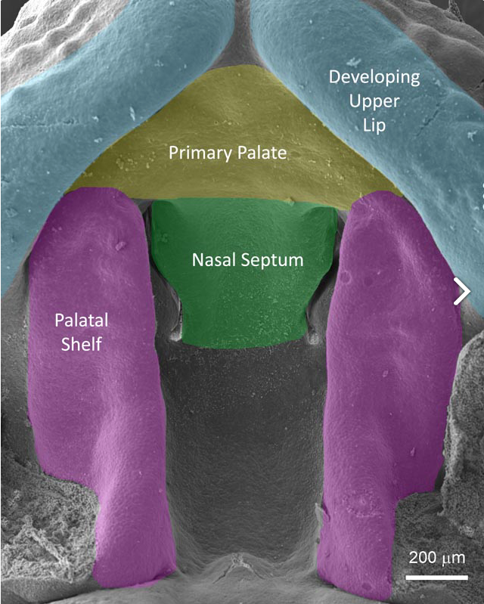
FaceBase Consortium: NIDCR Update 2018
Steven Scholnick, PhD
TGRB/NIDCR/NIH
5/15/18

Slide 2
A reminder of why we’re here
Facilitate craniofacial research by making large, integrated datasets available to the wider scientific community
Develop the tools and datasets needed for a comprehensive, systems-wide, understanding of the developmental processes that create the face during embryogenesis and how those processes go awry.

Slide 3
A reminder of why we’re here
We’re entering year 5 of these awards so time is of the essence
Ideally, all datasets will be curated and available on FaceBase by 4/30/19

Slide 4
Update topics
Introductions
SLG members
NIDCR Staff
Additional funding opportunities for:
Using FaceBase data
Genetics/genomics research
Support for training
Gabriella Miller Kids First Initiative
Purpose and potential funding opportunities

Slide 5
Related FOA: PAR-16-362
NIDCR Small Research Grants for Secondary Analysis of FaceBase Data (R03)
Encourage “outside” use of FaceBase data
Encourage analyses that tie together data from different FaceBase projects
Larger than normal R03 budget
Maximum direct cost of $200,000 for the maximum of a two year funding period
Not intended for support of data generation
Some generation of data for validation is okay

Slide 6
Related FOA: PAR-16-362
Six awards have been funded so far:
Functional genomics to identify miRNA targets in the developing face; Joan Hooper; University of Colorado, Denver
A web-based craniofacial disease gene discovery tool; Salil Lachke; University of Delaware
Genomewide Copy Number Variation Analysis and Association with Facial Shape Variation; Tamim Shaikh; University of Colorado, Denver
Exploratory Statistical Analysis of Differential Network Behaviors Based on Gene Expression Atlas of Palate Development; Somnath Datta; University of Louisville
Transcripts and Functions Targeted by Non-coding RNAs in Palate Development; Junichi Iwata; University of Texas Health Science Center, Houston
Identification of microRNAs associated with cleft lip; Junichi Iwata; University of Texas Health Science Center, Houston
If you want to know more about these projects, you can look them up in the NIH RePORTER
Recipients of these grants are expected to share the results of their analyses through FaceBase

Slide 7
Craniofacial genetics-related R01 FOAs
PAR-17-236: Genetic Susceptibility & Variability of Human Structural Birth Defects (R01)
NIDCR contact: Steve Scholnick
​PAR-16-295/PA-16-296: ​Factors Underlying Differences in Female and Male Presentation for Dental, Oral, and Craniofacial Diseases and Conditions (R01/R21)​
NIDCR contact: ​​Preethi Chander

Slide 8
Craniofacial genetics-related R03 FOAs
PAR-16-070: NIDCR Small Research Grants for Data Analysis and Statistical Methodology Applied to Genome-wide Data (R03)
NIDCR contact: Lu Wang
PAR-16-323: Small Research Grants for Establishing Basic Science-Clinical Collaborations to Understand Structural Birth Defects (R03)​
NIDCR contact: Steve Scholnick

Slide 9
Training FOAs
PAR-16-179: Short-term Mentored Career Enhancement Award in Dental, Oral and Craniofacial Research for Mid-Career and Senior Investigators (K18)
NIDCR contact: Lynn King or Lu Wang
PA-18-397/PAR-18-398: NIH Pathway to Independence Award (Parent K99/R00)
NIDCR contact: Leslie Frieden
PA-16-288: Research Supplements to Promote Diversity in Health-Related Research (Admin Supp)
NIDCR contact: Lynn King

Slide 10
Gabriella Miller Kids First Initiative
Congressionally mandated NIH Common Fund Initiative examining the genomics of pediatric cancers and structural birth defects
https://commonfund.nih.gov/kidsfirst/overview
$12.6 million projected for each of 10 years
WGS of existing cohorts and development of a data resource
Cleft lip/palate, craniosynostosis, & craniofacial microsomia cohorts
PAR-18-733: Small Research Grants for Analyses of Data for the Gabriella Miller Kids First Data Resource (R03 - Clinical Trial Not Allowed)
NIDCR contact: Lu Wang

Slide 11
BD2K
Data Commons, pilot now running
Carl and his group are involved
The Data Discovery Index Coordination Consortium
http://biocaddie.org
BD2K Fundamentals of Data Science Series
http://www.bigdatau.org/data-science-seminars

Slide 12
FaceBase 3
The current U01s expire on 4/30/19
The FaceBase 3 RFA is out (RFA-DE-19-003) but the format for the next iteration will be very different:
Hub only, no spokes
The number of labs outside of the consortium generating ”spoke type” data has really grown.
The FB3 hub will be charged with working with those labs to incorporate their data into FaceBase.
A good way for NIDCR-funded craniofacial biology labs to satisfy their data sharing requirements

