Slide 1
Human Genomics Analysis Interface (U01-DE024425)
Mary L. Marazita
Elizabeth J. Leslie, Eleanor Feingold, Harry Hochheiser
University of Pittsburgh
Center for Craniofacial and Dental Genetics
FaceBase Annual Meeting
May 1-2, 2017

Slide 2
GOALS
Develop software interface for Human Genomics Results
No access to individual level data
Secure hardware
Identify appropriate craniofacial and oral genomics projects
From research community, dbGaP, publications
Create and display results from genomics projects
E.g. Manhattan plots, LocusZoom

Slide 3
APPROACH
User friendly, save user time
Pre-calculate results databases (e.g. p-values at SNPs)
For all relevant subsets: by ethnicity, by genotyped versus imputed panels, by phenotype, by environmental factors
Customized: with input from PIs (e.g. published results)
Prepare Manhattan plot files
LocusZoom interface for specific SNP/gene/region requests
Pre-run typical requests to save time

Slide 4
UPDATES
Hardware established
Basic software created
WebSite created and updated
Multiple projects uploaded
Orofacial Clefting, Facial Variation, Dental
Project pages created
Results databases and interface created

Slide 5
UPDATES
Replacing LocusZoom
Local version-faster
New programmer
Results databases in preparation for:
CL/P GWAS: Chinese, African, multiple new US
Facial Variation GWAS: multiple collaborations and phenotypes
Earlobe morphology GWAS
Dental GWAS: Scandinavian

Slide 6
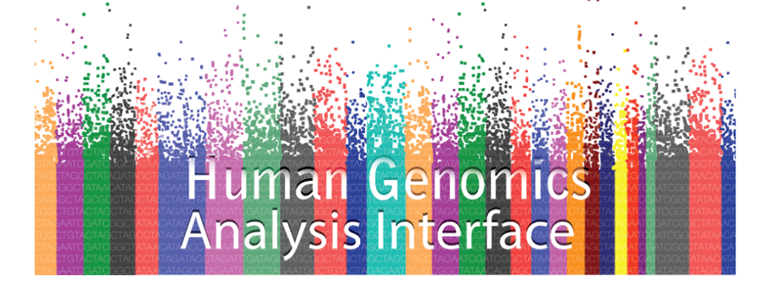
WEBSITE
FaceBase.sdmgenetics.pitt.edu
Link also available on the FaceBase.org Home page, and our FaceBase Project page

Slide 10
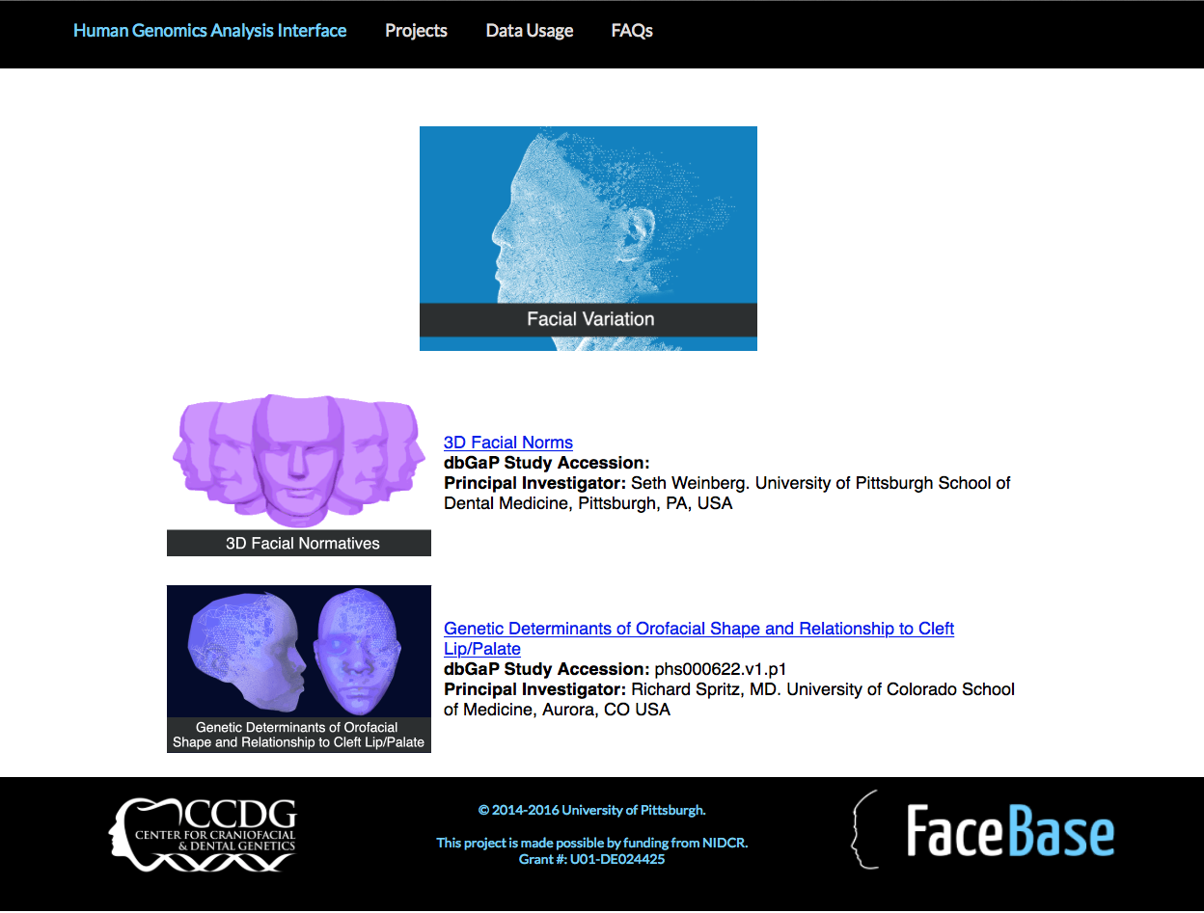

Slide 12
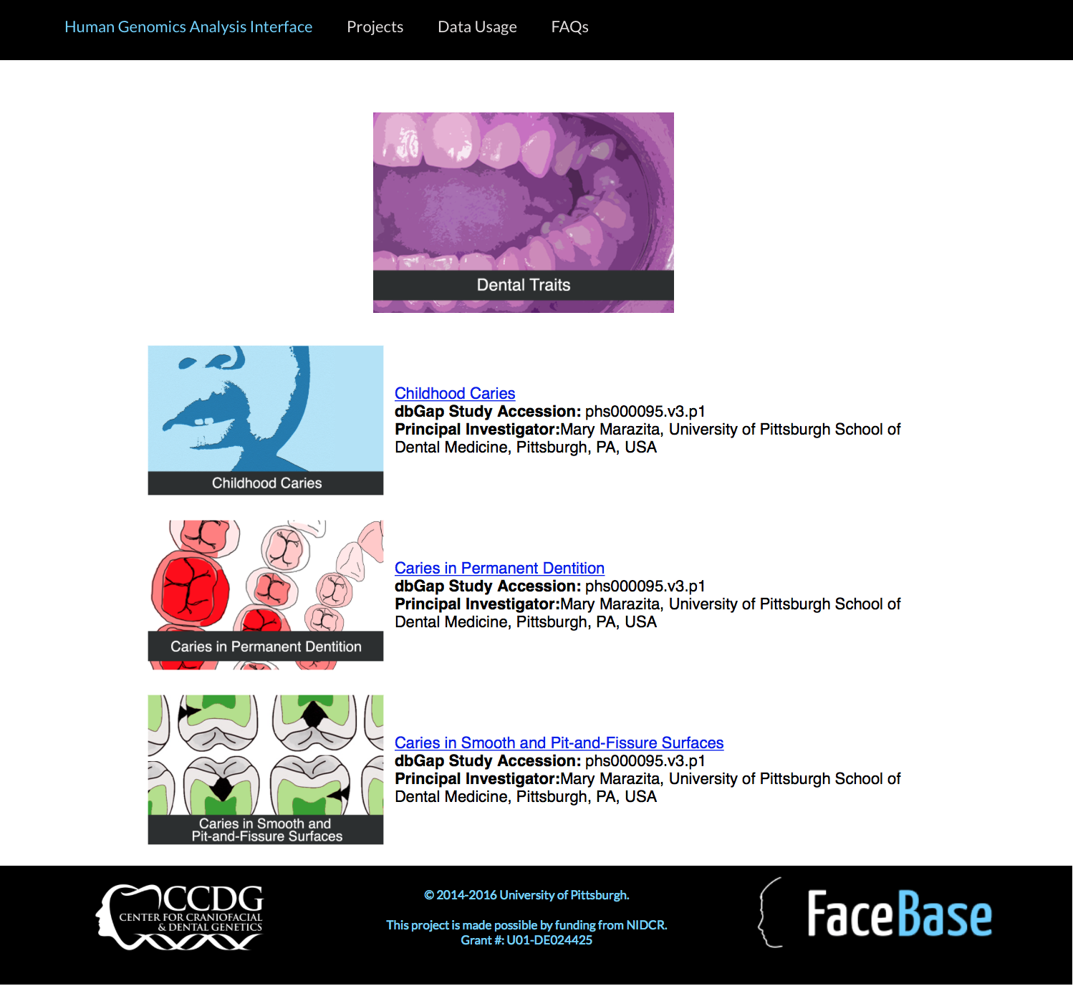

Slide 14
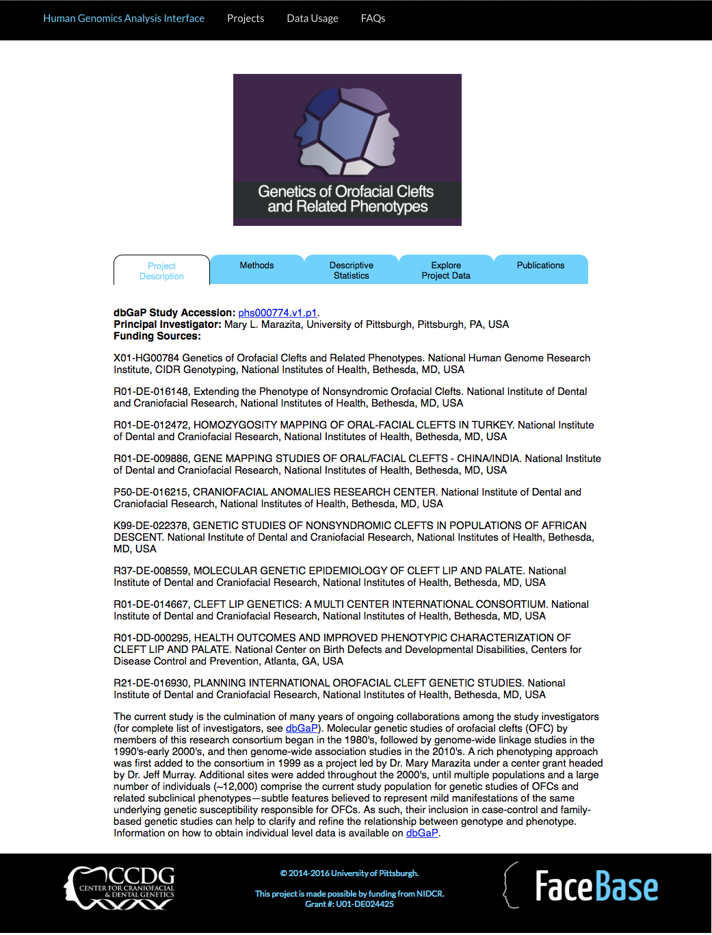

Slide 15
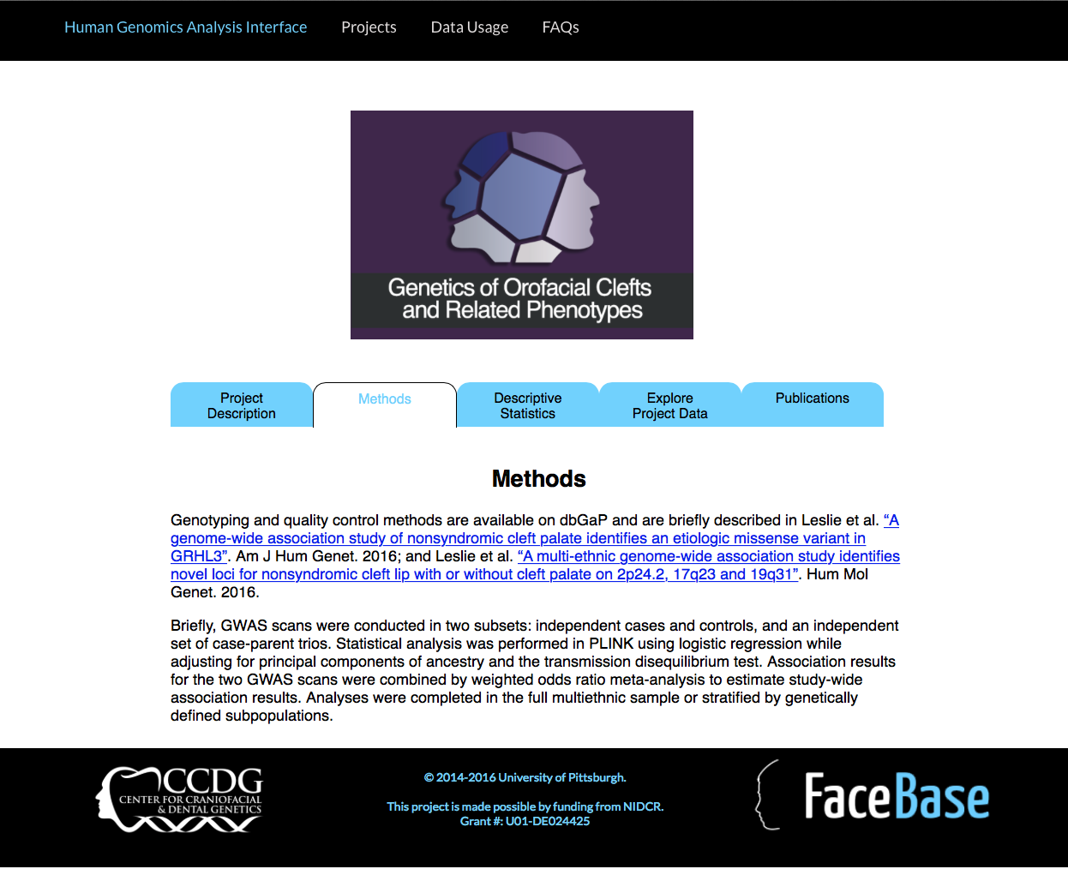

Slide 16
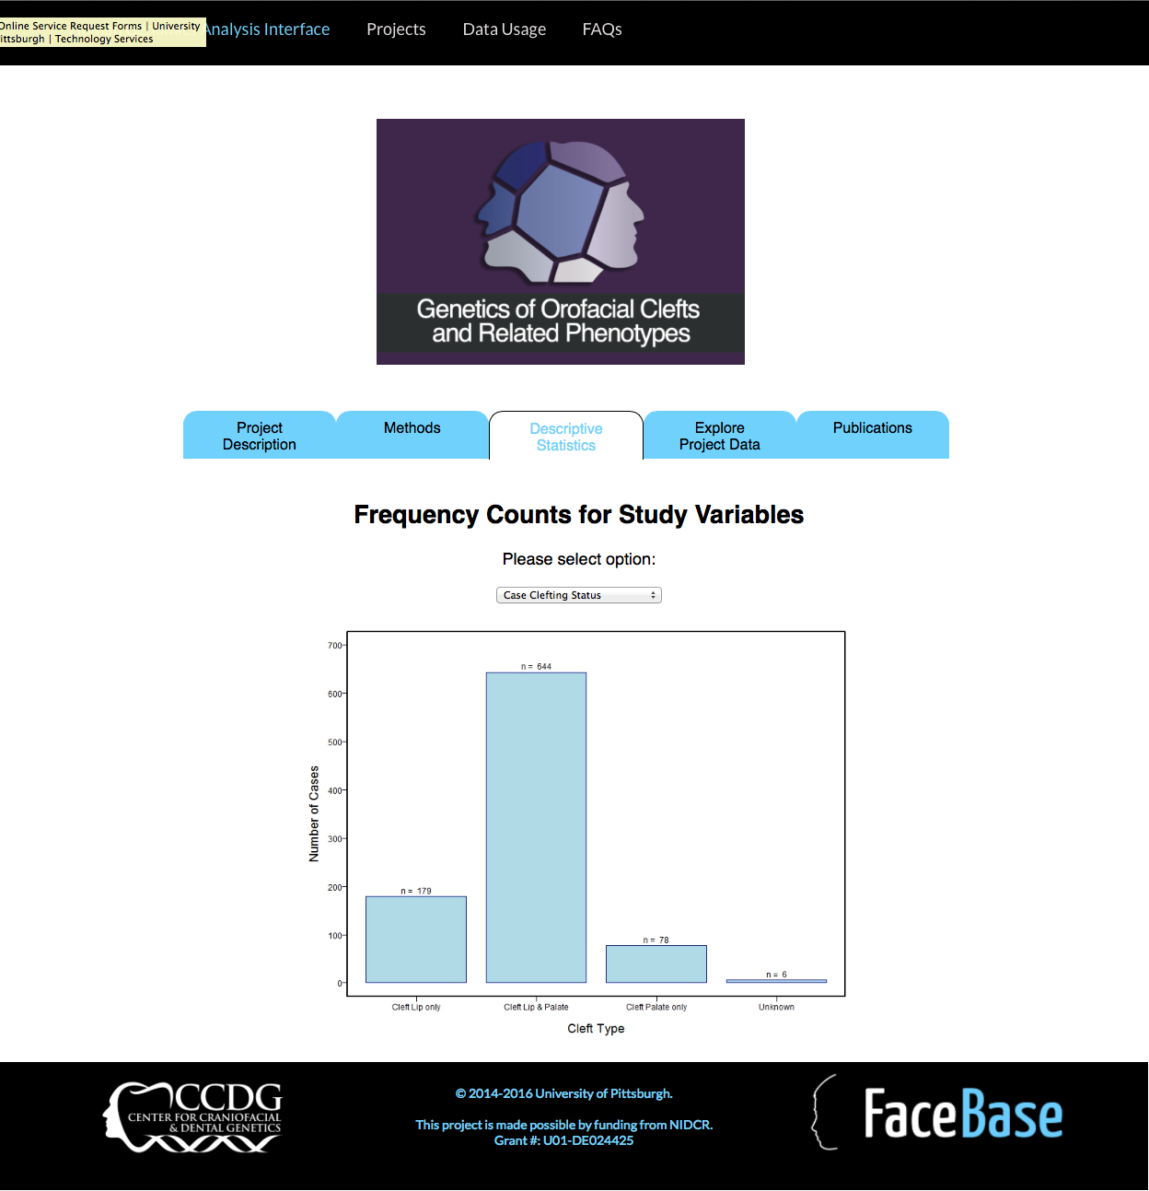

Slide 17
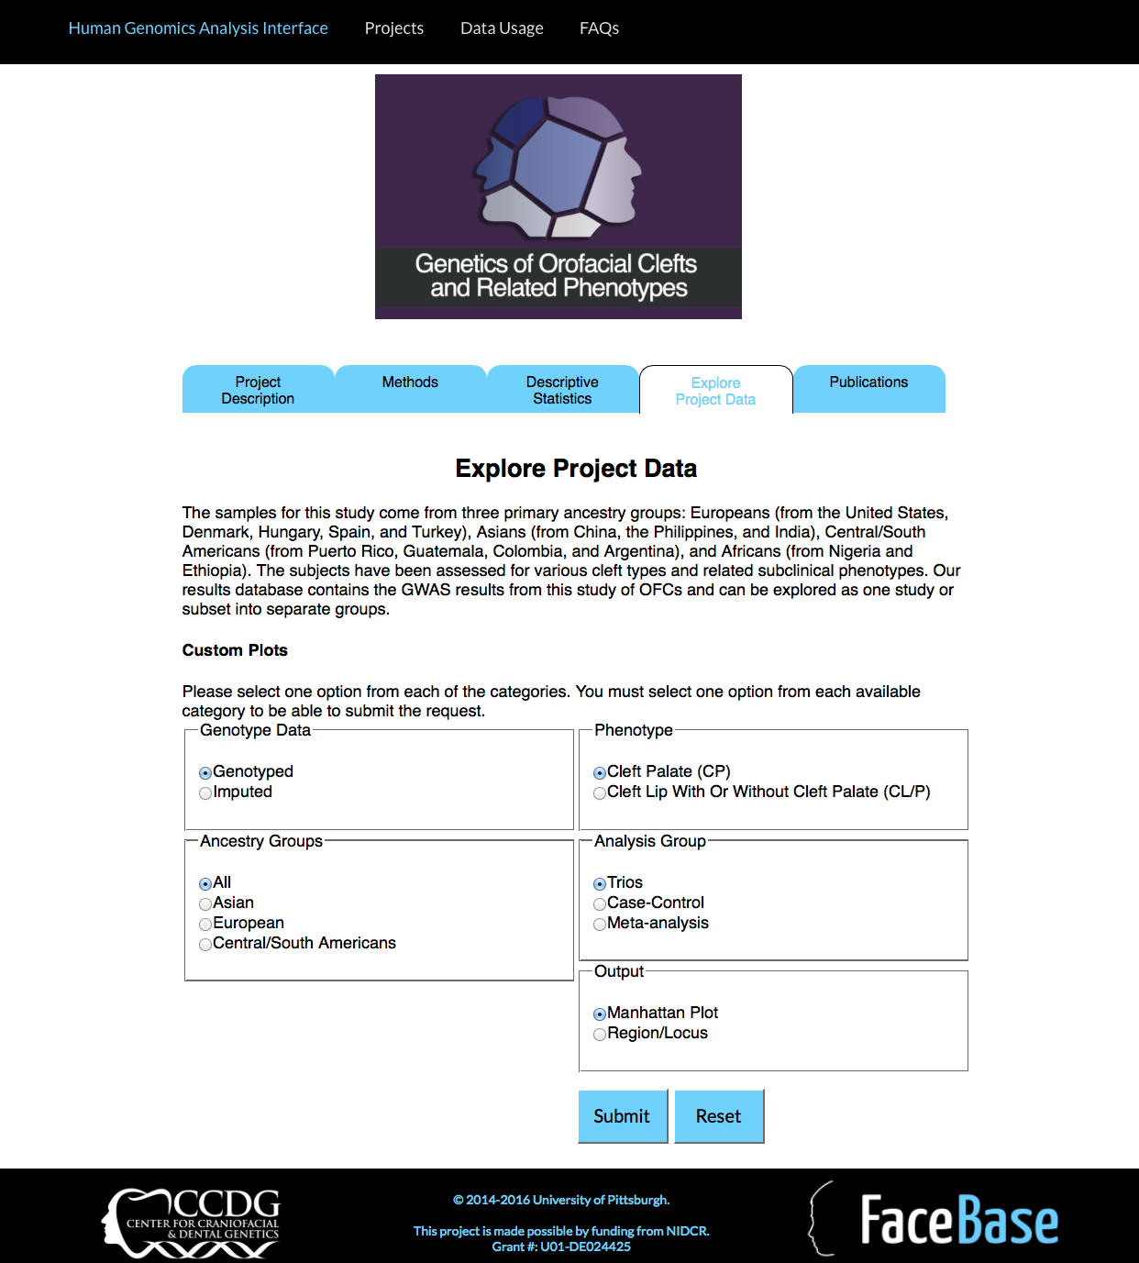

Slide 18
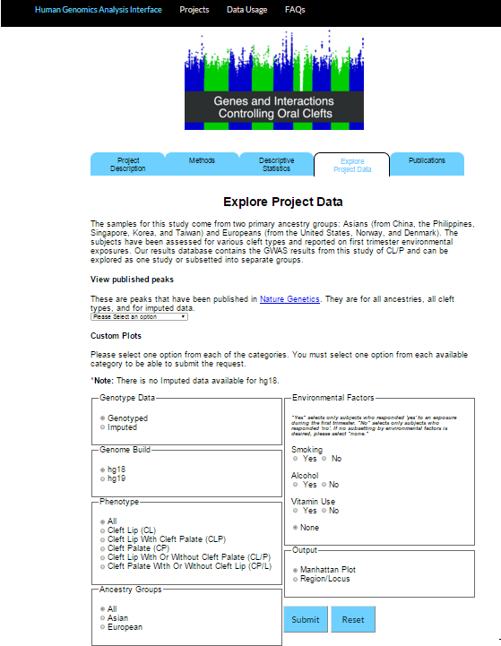

Slide 19
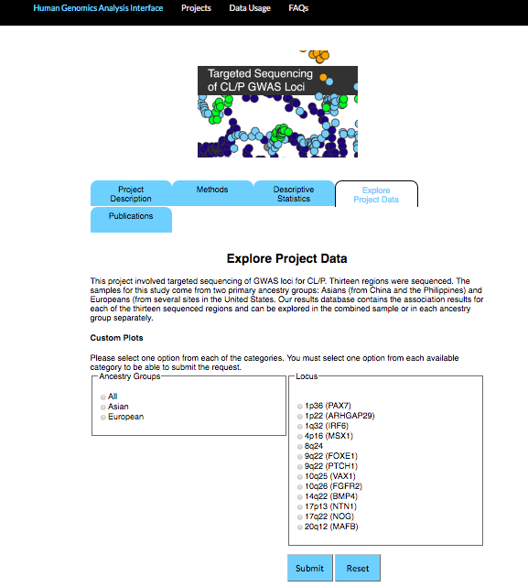

Slide 21
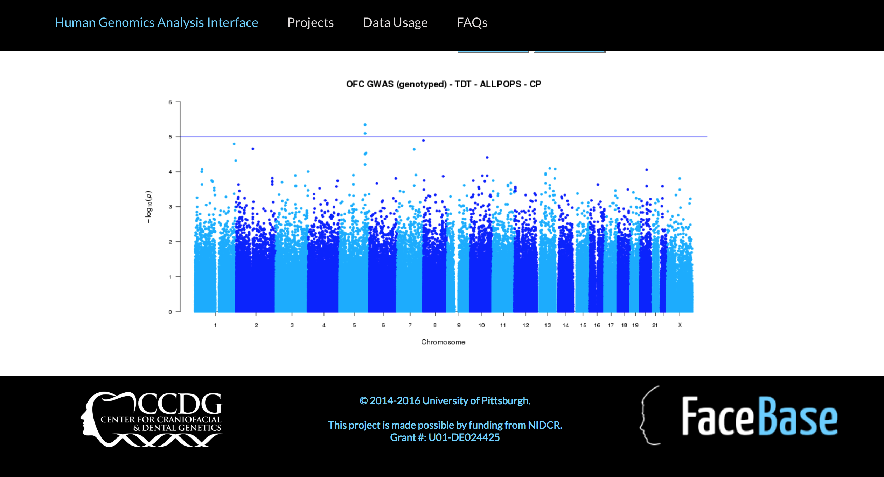

Slide 22
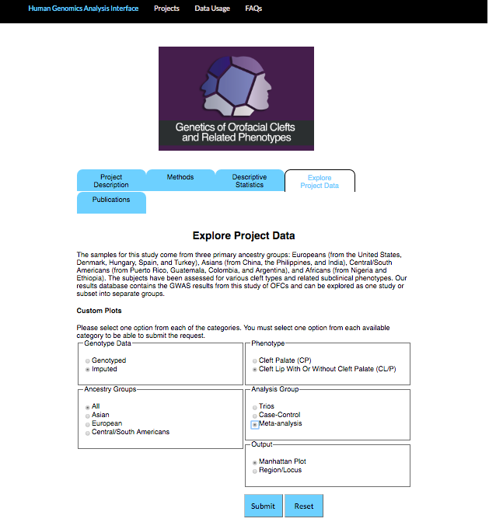

Slide 23
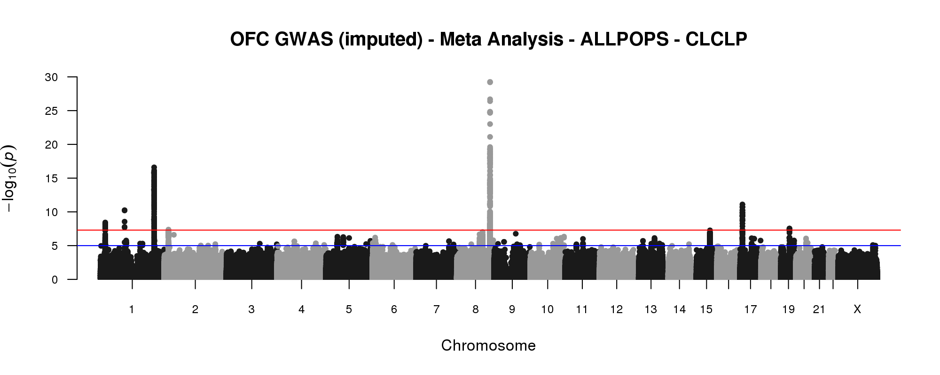

Slide 24
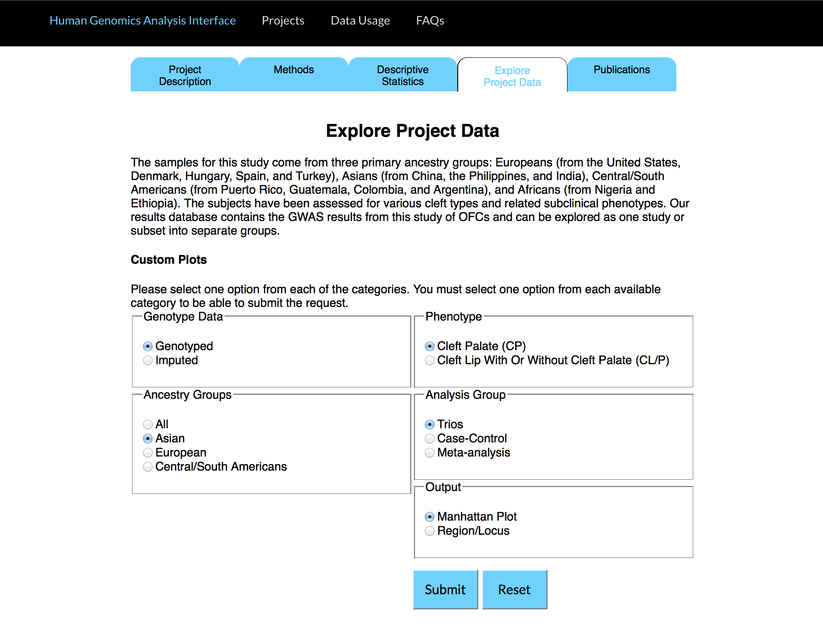

Slide 26
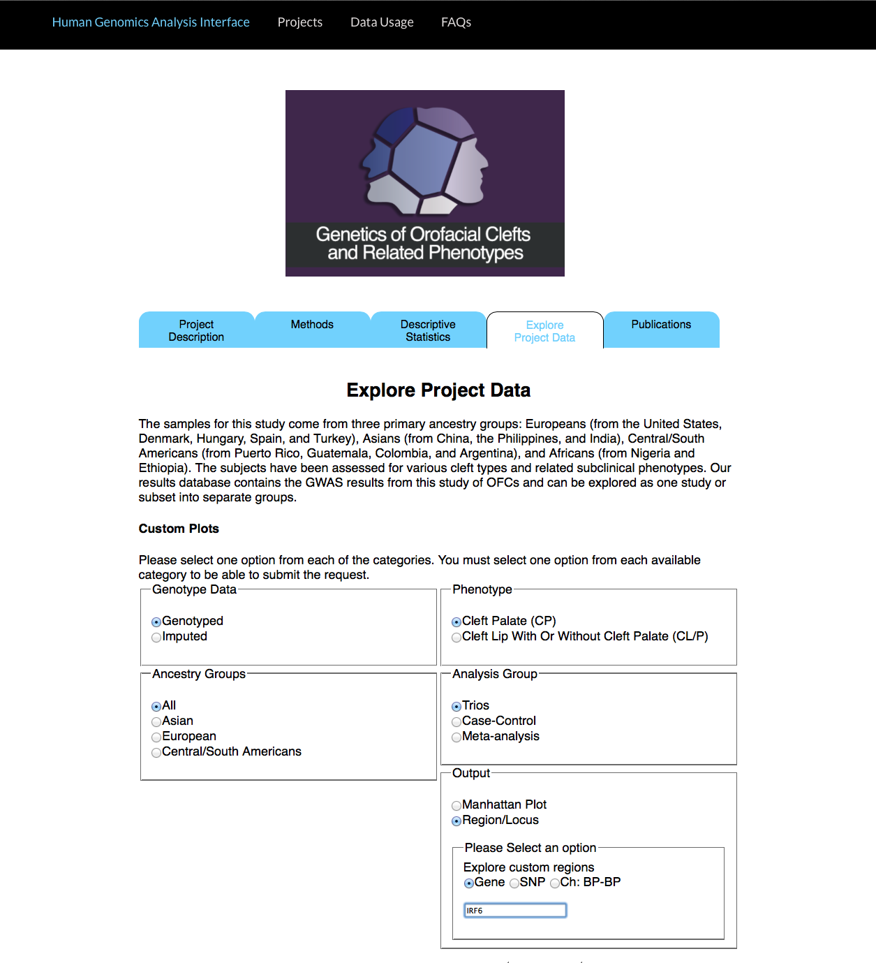

Slide 28
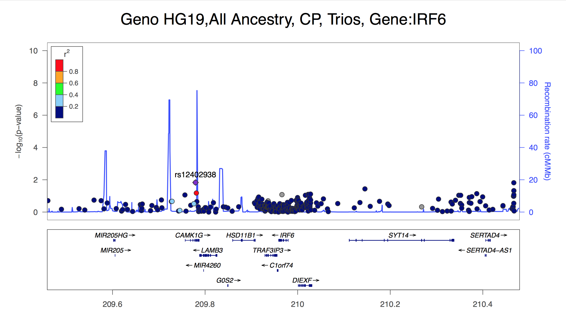

Slide 29
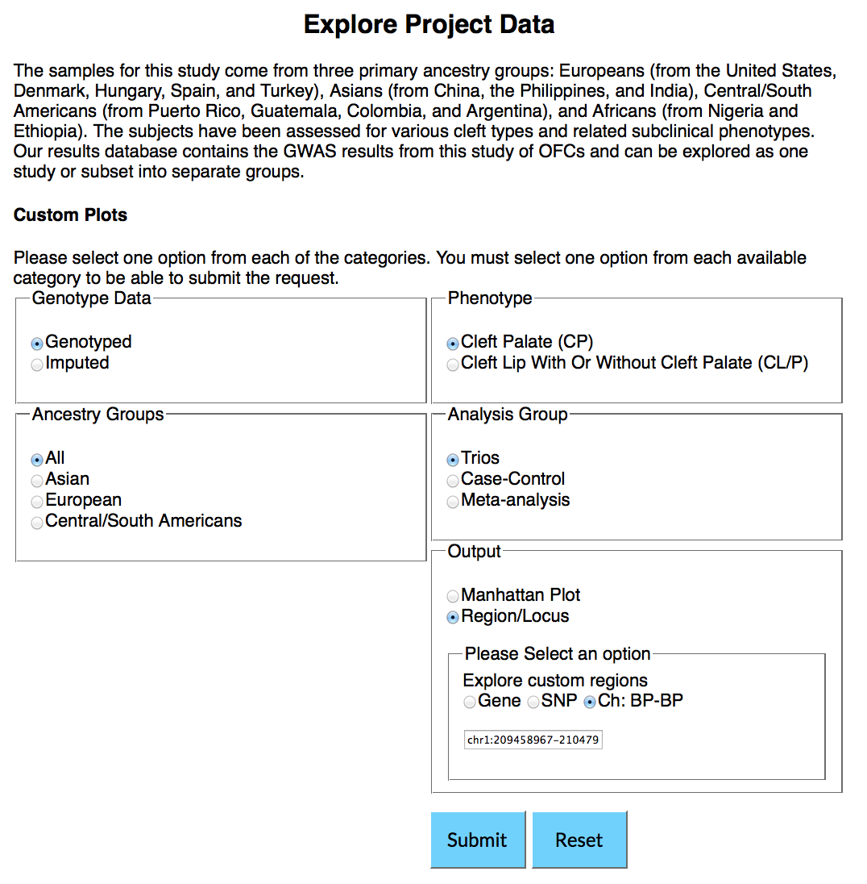

Slide 31
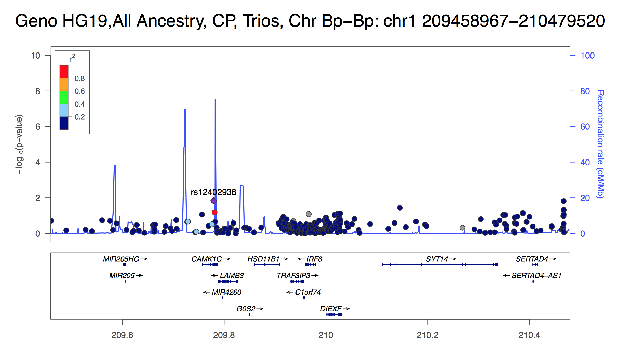

Slide 34
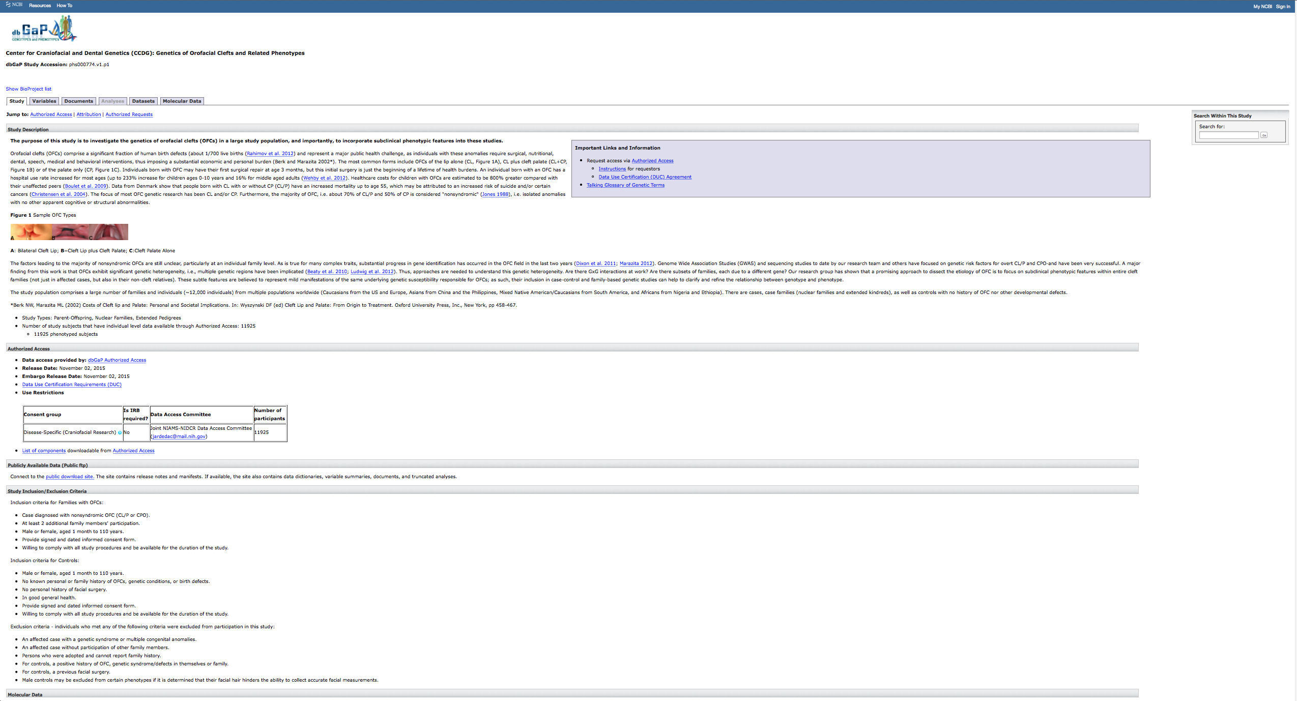

Slide 36
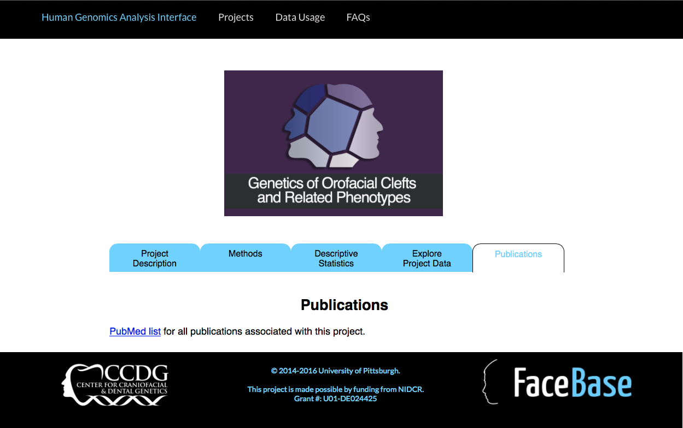

Slide 37
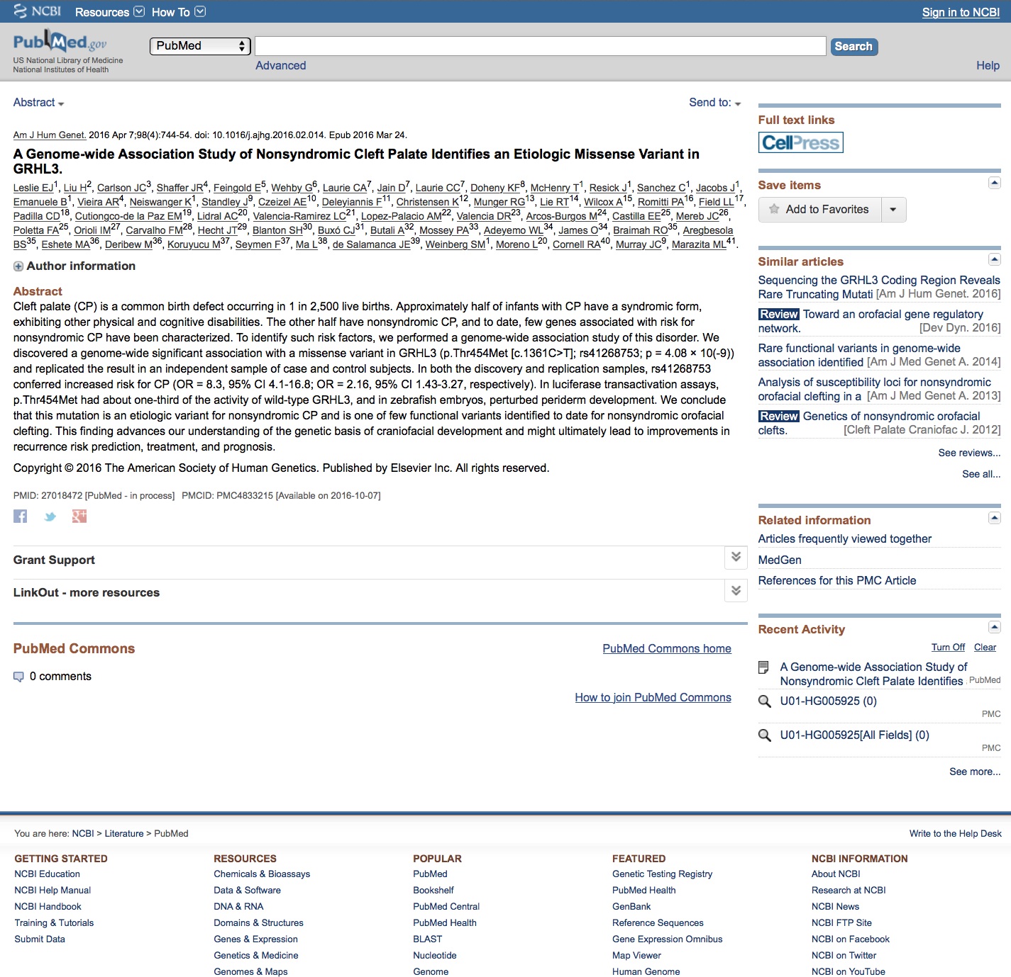

Slide 38
UPDATE: VISITS TO THE SITE

Slide 39
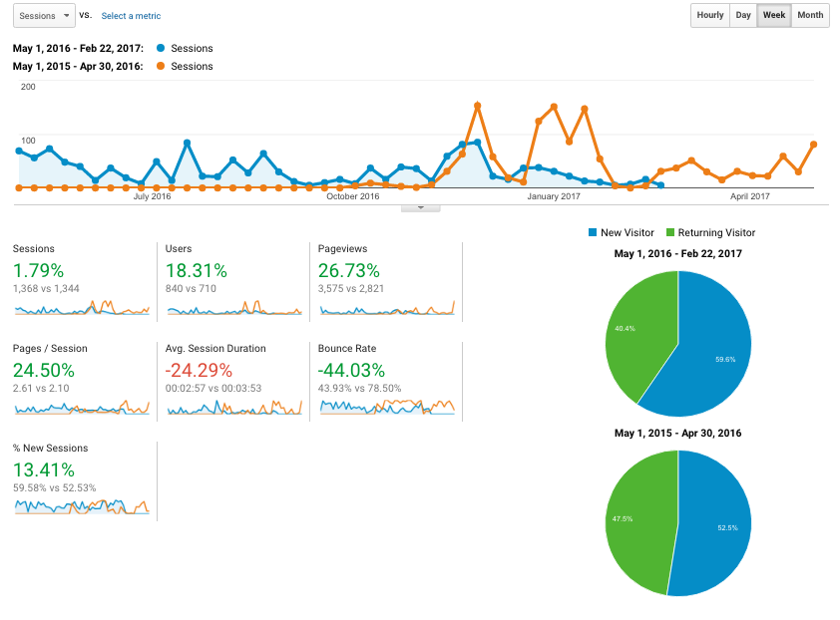

Slide 40
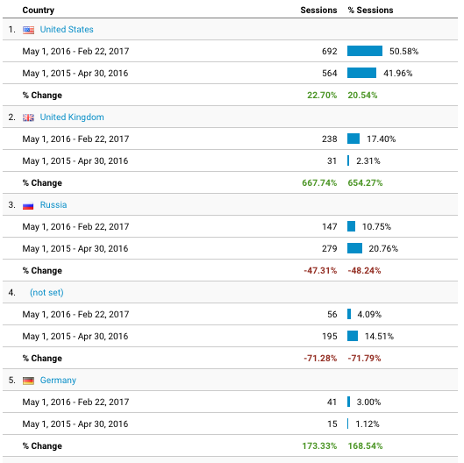

Slide 41
FUTURE PLANS
Update Locus Zoom
Add datasets
CL/P GWAS: Chinese, African, multiple new US
Facial Variation GWAS: multiple collaborations and phenotypes
Earlobe morphology GWAS
Dental GWAS: Scandinavian Incorporate additional functionality
Citing the project in papers, dbGaP
Additional functionality

Slide 42
ACKNOWLEDGEMENTS
Staff/Students:
Tamra Mitchell
Annette Krag-Werner
Jenna Carlson
Jim Gallagher
Lance Kennelty
Myoungkeun Lee
Tom Maher
Justin Stickel
Funding NIDCR
U01-DE024425
Faculty:
Mary Marazita
Elizabeth Leslie
Eleanor Feingold
Harry Hochheiser

Slide 44
