Slide 1
3D Analysis of Normal Facial Variation: Data Repository and Genetics
Principal Investigators: Seth M. Weinberg & Mary L. Marazita
Center for Craniofacial and Dental Genetics
School of Dental Medicine
University of Pittsburgh

Slide 2
Overall Aims
Create a large normative data repository of 3D facial surface images, quantitative facial measures and genome-wide association SNP markers (~600K)
Utilize this data repository to identify genetic loci that influence quantitative variation in midfacial form and shape

Slide 3
Aim 1: Normative Data Repository
Rationale: The need for 3D facial norms
Craniofacial normative data is currently restricted to traditional anthropometric or cephalometric measures
All suffer from major methodological and/or demographic limitations
Limited to simple linear distances or angles
Only summary-level data available
Comparing 3D to traditional methods can be problematic
Our proposed database will…
Include 3D landmark coordinates, linear distances and de-identified 3D facial surfaces
Provide end-users with individual-level data
Include a web-interface with flexible search tools to facilitate data mining
Serve as a resource for normative control data
Provide a test bed for the development of new 3D analysis tools

Slide 4
Aim 1: Normative Data Repository
We will collect 3D images, facial measures and DNA (Oragene) on 3500 unrelated healthy Caucasian individuals (age 5-40) at three US sites:
University of Pittsburgh
Seattle Children’s Research Institute
University of Texas Health Science Center (Houston)
1500 Subjects
1000 Subjects
1000 Subjects
Co-PI: Seth Weinberg
Co-PI: Mary Marazita
Co-I: Karen T.Cuenco
Co-I: Michael Cunningham
Co-I: Jacqui Hecht
Co-I: Chung How Kau
Demographic descriptors (e.g., Age, Sex, Ancestry)
50 individuals at each age interval for each sex
Exclusion criteria will include intrinsic or extrinsic factors affecting facial structure (e.g., syndromes, trauma)

Slide 5
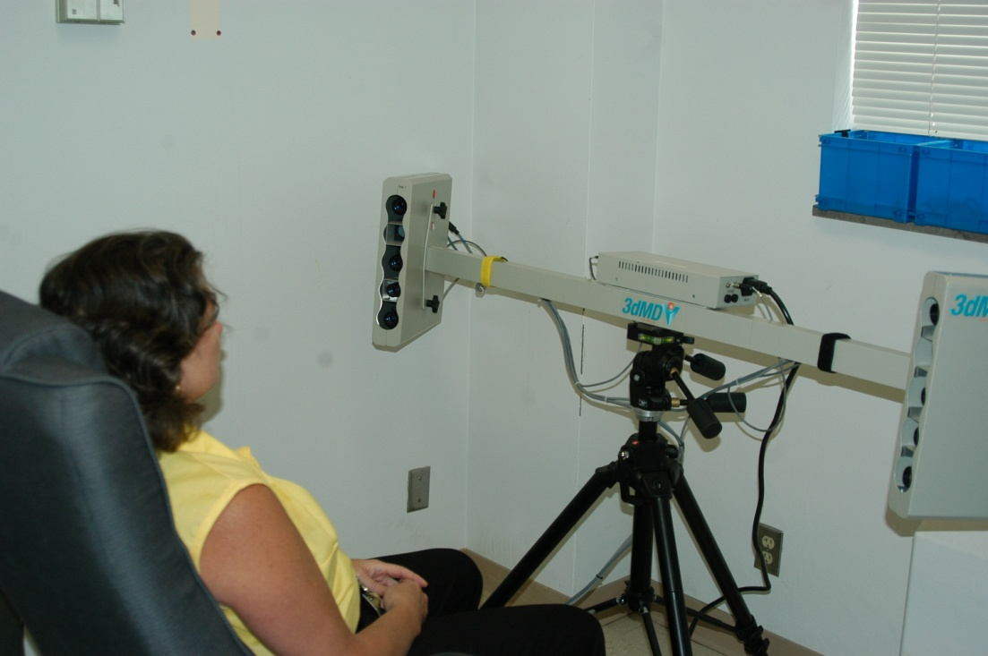
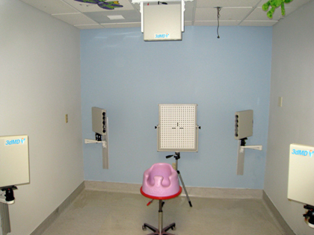
Aim 1: Normative Data Repository
Current 3D capture technology allows for quick and affordable surface imaging of large numbers of individuals
2-pod 3dMDface system
Capture Speed: 2 milliseconds
Capture area: ~180 degrees
5-pod 3dMDCranial system
Capture Speed: 2 milliseconds
Capture area: 360 degrees

Slide 6
Aim 1: Normative Data Repository

Slide 7
Aim 2: Genetic Basis of Midfacial Variation
Rationale
Although facial form is clearly heritable in humans, very little is known about the role of specific genes in modulating normal variation in facial features
QTLs influencing midfacial length and breadth have been identified in mice, dogs and baboons…but not in humans
Relevance to orofacial clefting
Embryologic face shape is hypothesized to predisposing factor to orofacial clefting.
Postnatally, subtle alterations in certain facial features can also serve as subclinical phenotypic markers for elevated genetic susceptibility to CLP (e.g. in non-cleft relatives)
Identifying loci that underlie normal variation in these features may help us hone in on genes that contribute to CLP liability

Slide 8
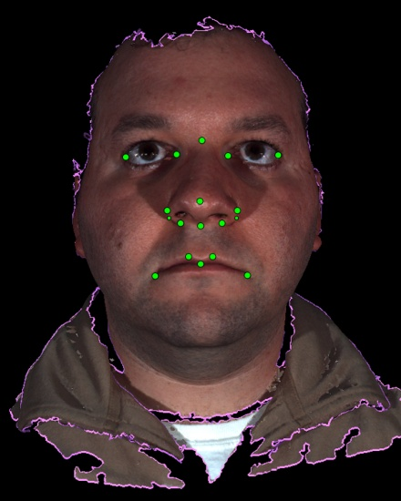
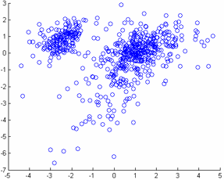
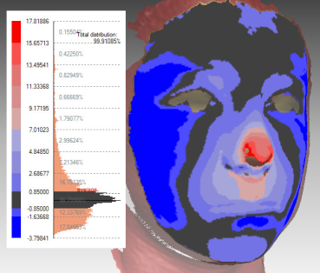
Aim 2: Genetic Basis of Midfacial Variation
Statistical Shape Analysis
(Geometric Morphometrics)
Identify major modes of midfacial shape variation in dataset
2nd Principal Axis of Shape Variation
Landmark Extraction
1st Principal Axis of Shape Variation
Regression of GWA markers on shape scores
Visualize the effects of influential loci on facial morphology

Slide 9
Interaction with FaceBase Data Hub
The bioinformatics team within the Data Hub will play an essential role in constructing our 3D normative database
Back-end database infrastructure
Scalable design for expanding project in future
Building in levels of security for restricted data
Front-end web interface
Designing flexible and easy to use data search and retrieval tools
Select demographic parameters
Select variables of interest
View summary page with query results
1
2
3
Start over
No
Proceed to download?
5
4
Download data to local PC or network
Select format for data
Yes

Slide 10
Interaction with Other FaceBase Investigators
Shape-Based Retrieval of 3D Craniofacial Data (PI: Linda Shapiro)
The analysis tools being developed as part of this project are designed to be used on the type of 3D surfaces contained within the normative database
Genetic Determinants of Orofacial Shape and Relationship to Cleft Lip/Palate (PI: Richard Spritz)
Considerable overlap with our study - focus on both mice and humans
More generally, results from our GWA analysis will hopefully inform other human and mouse genomic studies within the consortium and vice versa

Slide 11
Thank You
To collect and codify the facts of Variation is, I submit, the first duty of the naturalist.
- William Bateson (1893)

