Slide 1
Genetic Determinants of Orofacial Shape and Relationship to Cleft Lip/Palate
Richard A. Spritz, M.D.
Professor and Director, Human Medical Genetics Program
University of Colorado Denver
School of Medicine
Aurora, CO USA
HMGP

Slide 2
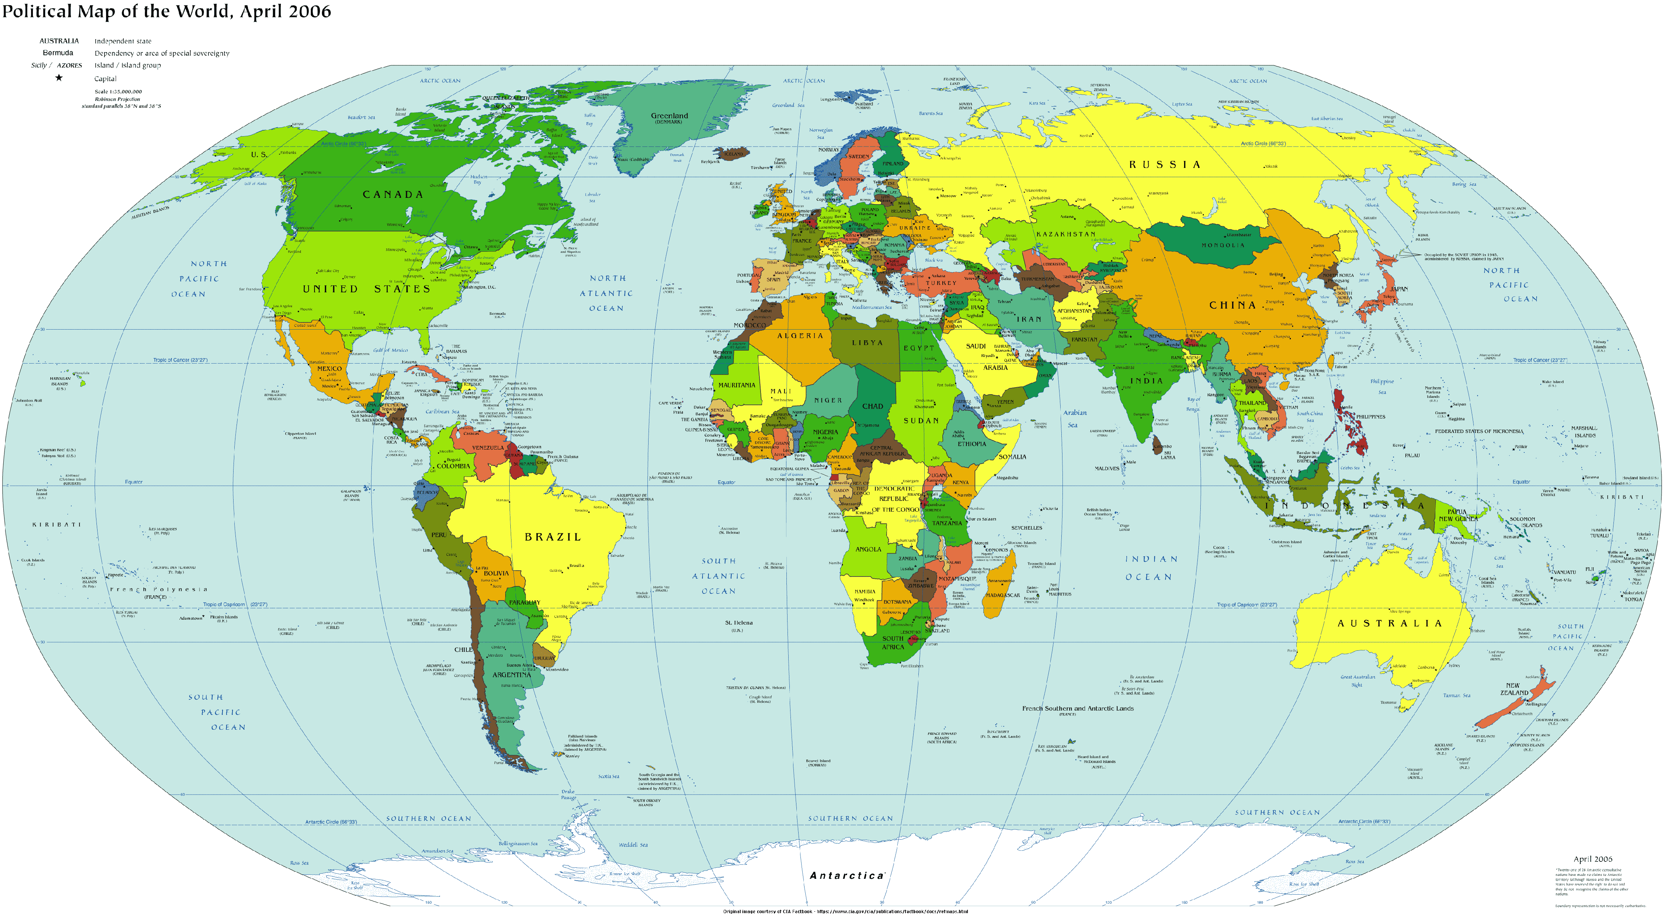
Collaboration Across Borders and Across Continents
Benedikt Hallgrimsson
Univ Calgary
Fernando Pardo-Manuel de Villena
Univ N Carolina
Ophir Klein
UCSF
Mange Manyama
Weill Bugando Univ Coll Hlth Sci
Mwanza, Tanzania
Rich Spritz
Robert Brayden
Univ Colo Denver

Slide 3
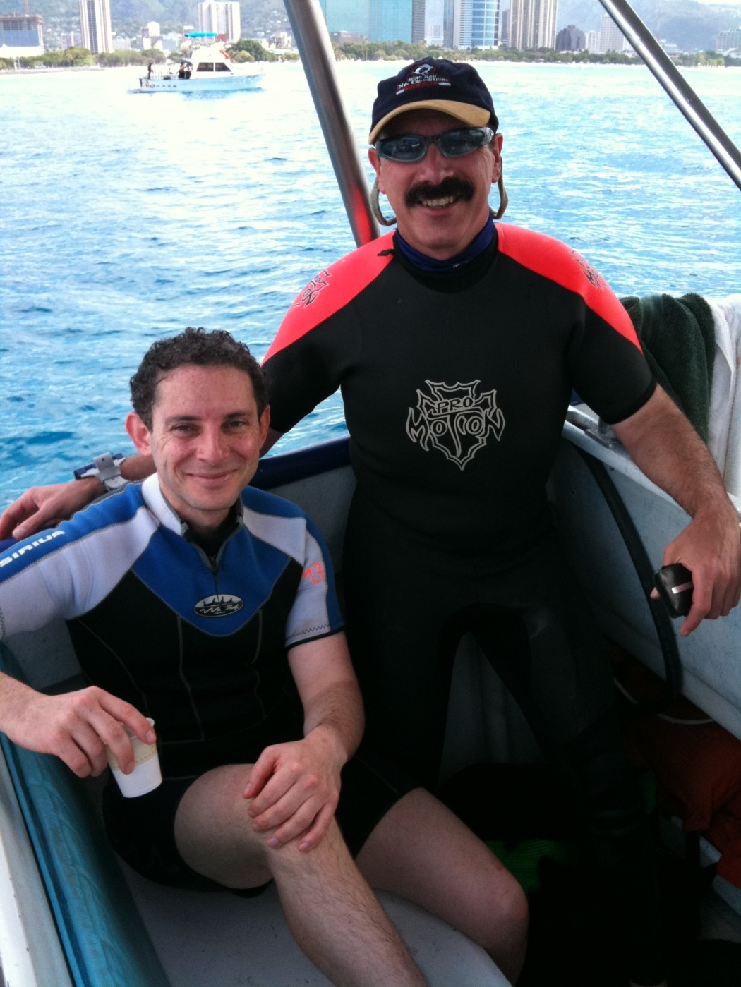
FaceBase Research Meeting

Slide 4
Specific Aims
Aim 1: Determine heritable orofacial morphometric variation among mouse strains
1. Orofacial morphometric phenotyping of the 8 founder strains of the Collaborative Cross during embryogenesis, at birth, & at 90 days of age
2. Detailed phenotyping of informative recombinant intercross (RIX) mice
Aim 2: Fine-map major QTLs) for these major heritable orofacial
morphometric parameters using the mouse Collaborative Cross
1. Generate the recombinant intercross (RIX) mice from the CC
2. Phenotype the RIX lines for the orofacial morphometric parameters selected in Aim 1
3. Fine-map major QTLs that underlie selected heritable orofacial morphometric parameters

Slide 5
Specific Aims
Aim 3. Test genetic association of candidate genes for mouse orofacial morphometric QTLs with human orofacial morphometric parameters
1. Carry out 3D white light morphometric digitization phenotyping and DNA collection from cohorts of normal children from specific ethnic groups with relatively higher (Asian), intermediate (Hispanic/Latino, non-Hispanic
white Caucasian), and lower (African) endemic frequencies of non-syndromic orofacial clefts.
2. Test whether positional/functional candidate genes located within QTLs responsible for major heritable orofacial morphometric parameters in mouse are genetically associated with homologous orofacial
morphometric parameters in humans.
3. Test whether candidate genes shown to be important for nsCLP by a current GWAS are genetically associated with normal human orofacial morphometric parameters.

Slide 6
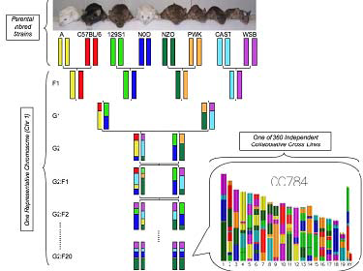
Generation of the Collaborative Cross
8 progenitor strains: A, C57, 129, NOD, ZND, PWK, CAST, WSB
All strains being sequenced (Sanger)
Capture 90% of genetic variation in mice
Funnel breeding scheme; 360 RI lines with mosaic genomes
All will be genotyped; 1-2 Mb genetic resolution

Slide 7
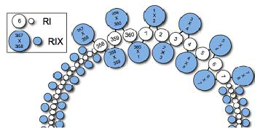
Loop Design to Generate Recombinant Intercross (RIX) Lines
‘Outbreed’ RI lines, each RI line crossed to two others (360 RIX), each RI contributing to two RIX, ♂ to♀ and ♀ to ♂
Can custom-breed up to 130,000 different RIX lines to test specific biological predictions

Slide 8
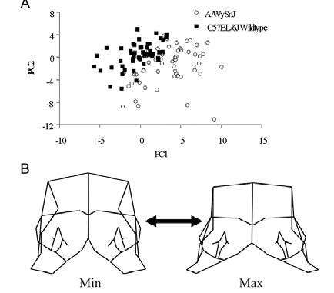
Comparison of A/WySnJ and C57Bl6J Lines (matched for stage)
A) Plot of the first two principal components
B) Wireframe deformation along PC1 in frontal view to show extemes

Slide 9
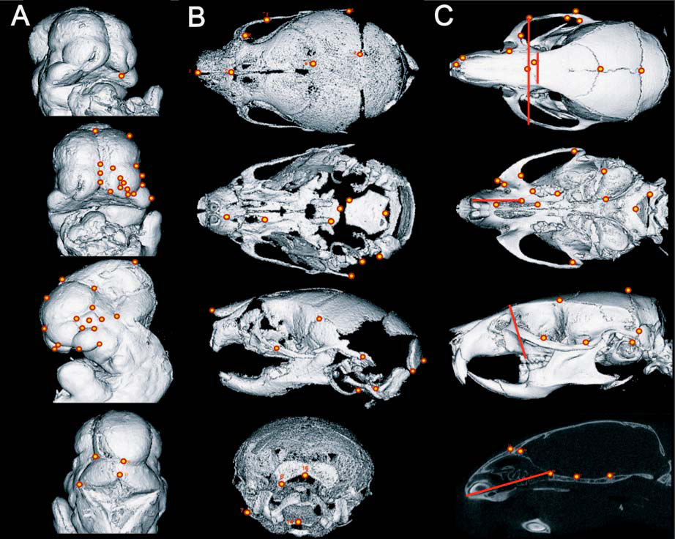
3D Landmarks used for Morphometrics of Mouse Samples
A) E9.5-11.0 Embryos
B) Neonates
C) Adults

Slide 10
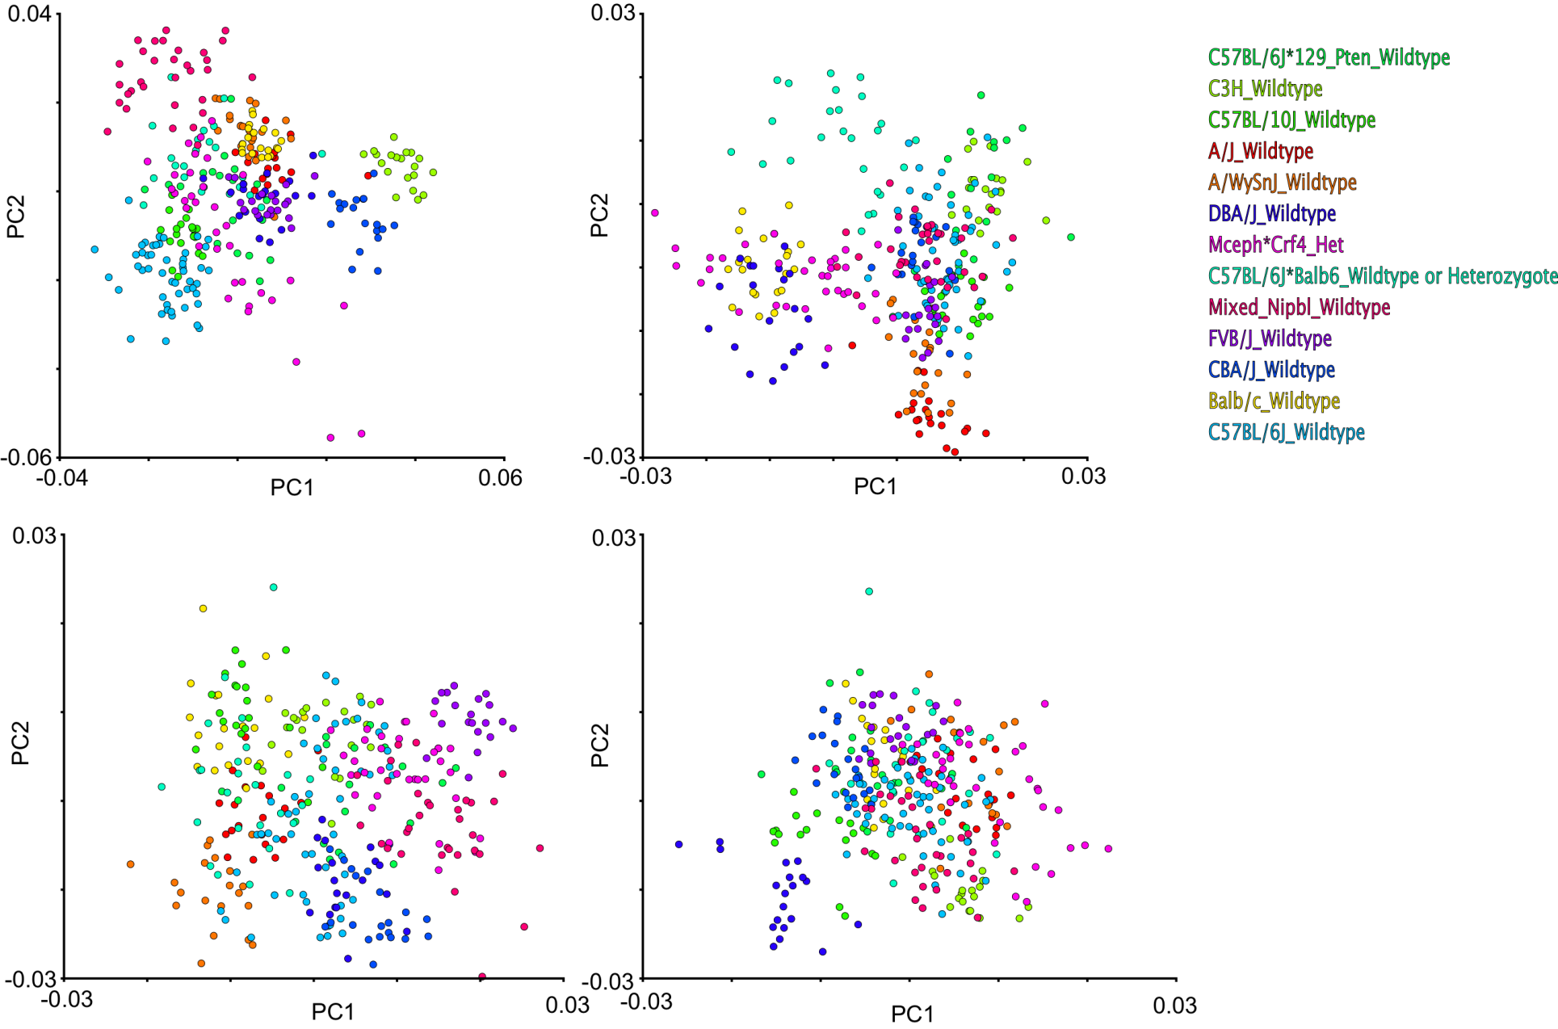
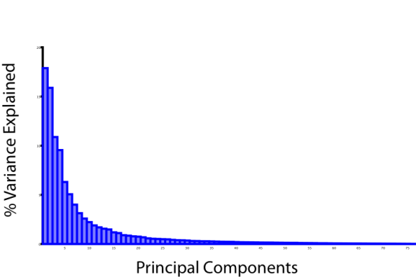
Plots of Scores for First 8 Principal Components for 8 CC Progenitor Strains

Slide 11
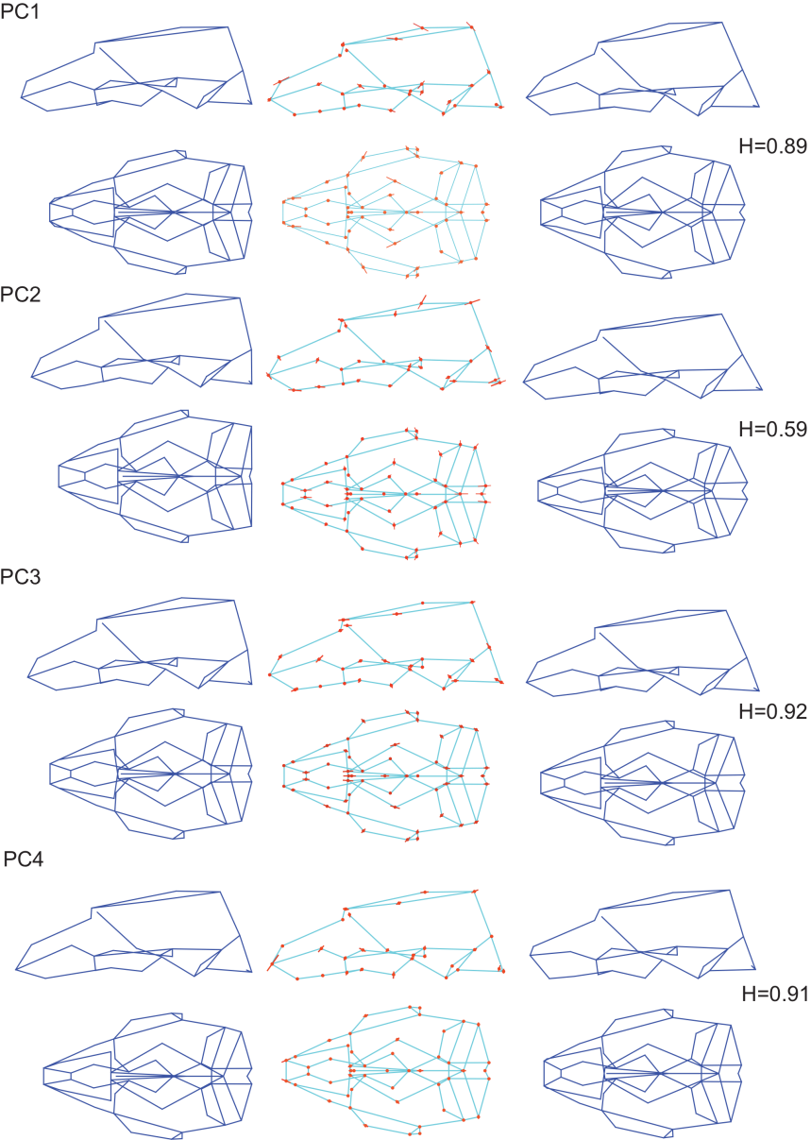
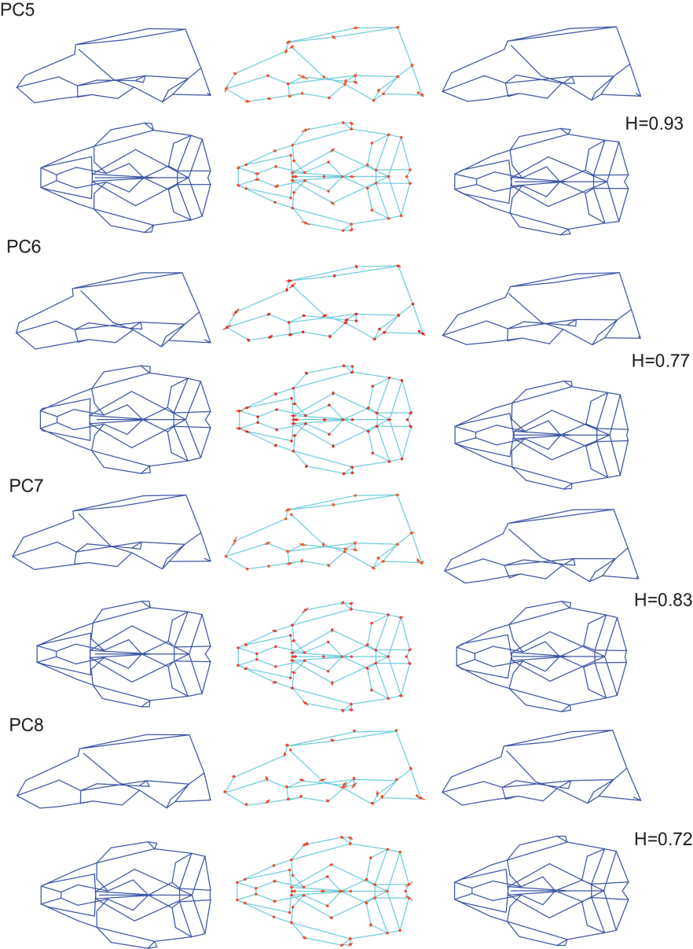
Wireframe Deformations and Landmarks 1st 9 PCs (to scale)

Slide 12
Heritabilities of 1st 8 Principal Components among the 8 Progenitor Strains of the CC (matched for stage)
PC1 0.89
PC2 0.88
PC3 0.64
PC4 0.82
PC5 1.00
PC6 0.83
PC7 0.57
PC8 0.67

Slide 13
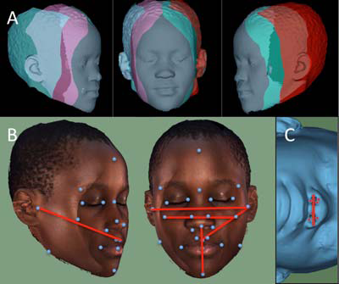
Human 3D Orofacial Morphometric Analysis
A) Scan with 3 object maps merged to produce single dataset
B) Scan with texture superimposed to show landmarks
C) Rotated to show landmarks around nose
Standardize for age, sex, BMI by regression

Slide 14
Human 3D Orofacial Morphometric Analysis
Scan and collect saliva for DNA from:
~2000 East Asian (high risk CLP)
~1500 Non-Hispanic white (intermediate risk CLP)
~2400 USA Hispanic/Latino (intermediate risk CLP)
~3000 African (low risk CLP)
To limit heterogeneity, subjects from Indian subcontinent, Phillipines, Micronesia will be excluded
Candidate gene association or QTL GWAS?
Candidate gene association of GWAS?

